Slide 1
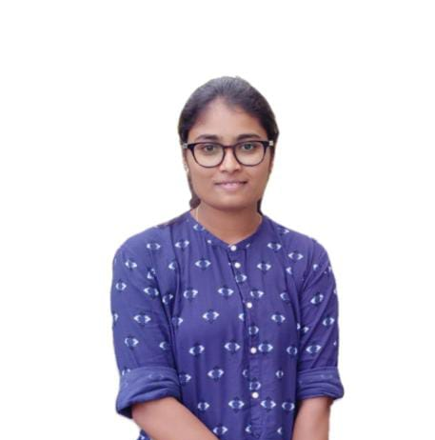

MEGHANA L
Analyst/Software Engineer
Bachelor of Engineering and Technology, Electronics and Instrumentation Engineering : 2017 - 2021
Bangalore
meghana.l@capgemini.com
Skills
+91 7676739448
A4
TECHNICAL | OutSystems, PowerApps,C, C++, Core Java Spring Boot, Advance Java.
DATABASE | SQL database – Oracle, MySQL No SQL database – Postgresql
UI Tech | HTML 5 & CSS 3,JavaScript and Bootstrap
Tools | Git
Add On skills | Peer learning, Github,Maven, Postman.
Additional Skills: | Project Management, Team Building, Project Management, Team Leader, Strategic/Tactical Planning, Business Analysis and Development, Excellent Communication and Interpretation skills
AWS Certified Cloud Practitioner
POC ON OUTSYSTEMS : --
Online Chatting Application
Created chat application using OutSystems where users can create their account and chat with registered users privately in one-to-one chatting or they can chat with all the available users in the public chat section.​
JAVA PROJECT:-
Covid Vaccine Registration
(Based on Java Spring boot and Angular) (Front-end-Angular, Back-end Spring boot):- A Covid Vaccine Registration allows the user to register for vaccine on particular day and time and also the location where they wish to have the vaccine
Worked more than one ETAP Project
BRG Sustainability Portal
Tech Audit Portal
Trained On OUTSYSTEMS and POWERAPPS
Hands on Experience in creating Traditional and Reactive application on outsystems.
Proficient in creating OutSystems Applications.
Hands on Experience in creating Traditional and Reactive application on PowerApps.
Proficient in creating PowerApps Applications.
Hands on experience in developing web pages using HTML5, CSS3, Object Oriented Java script. Good understanding of Document Object Model (DOM) and DOM Functions.
Hands on experience in creating microservices with Spring boot, Post Man, Swagger API

